Slide 1
Chapter 3
Big Data Analytics

Slide 2
Learning Objectives and Learning Outcomes
Learning Objectives | Learning Outcomes
Big Data Analytics What is big data analytics and what it isn’t? Why is big data analytics important? What is data Science? Getting familiar with the terminologies used in the big data environment. | To understand the significance of big data analytics. To understand the role of data scientist. To understand the various terminologies used in the big data environment.

Slide 3
Session Plan
Lecture time 45 to 60 minutes
Q/A 15 minutes

Slide 4
Agenda
What is Big Data Analytics?
What Big Data Analytics isn’t?
Classification of Analytics
Why is Big Data Analytics Important?
Data Science
Data Scientist … Your New Best Friend!!!
Terminologies Used in Big Data Environment
In Memory Analytics
In Database Processing
Massively Parallel Processing
Difference between Parallel versus Distributed Systems
Shared Nothing Architecture
Consistency, Availability, Partition Tolerance (CAP): Theorem Explained
Few Top Analytics Tools

Slide 5
What is Big Data Analytics?

Slide 6
What is Big Data Analytics?
Notes:
Big data analytics sets the stage for better and faster decision making. It is about leveraging technology to help with analytics. It spells a tight handshake between the communities of business users, IT and data scientists. It when properly utilized leads to gaining a richer, deeper and wider insights into the business, the customers and the partners.

Slide 7
What Big Data Analytics isn’t?

Slide 8
What Big Data Analytics isn’t?
Notes:
Big data analytics is not here to replace RDBMS or data warehouse. It is much more than technology. It is about dealing with not just the massive onslaught of huge volumes of data but also dealing with great variety and velocity of data. It works on the philosophy of “move code to data”.

Slide 9
Analytics 1.0, 2.0 and 3.0

Slide 10
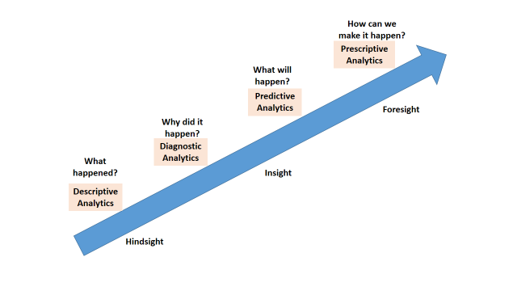
Analytics 1.0, 2.0 and 3.0
Notes:
Analytics 1.0 → deals with historical data to report on events, occurrences of the past.
Analytics 2.0 → helps to predict what will happen in future
Analytics 3.0 → is about predicting what will happen and to best leverage the situation when it happens.

Slide 11
Data Science

Slide 12
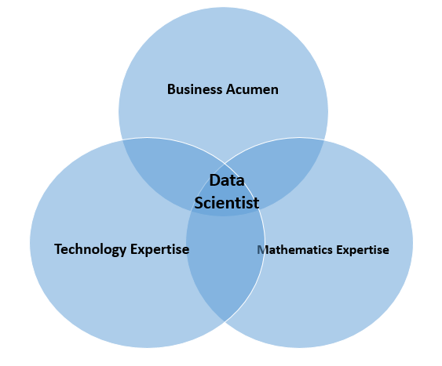
Data Scientist
Notes:
Data Science is the process of :
Collecting raw data from multiple disparate data sources.
Processing the data.
Integrating the data and preparing clean datasets.
Engaging in explorative data analysis using model and algorithms.
Preparing presentations using data visualizations (commonly called Infographics, or BizAnalytics, or VizAnalytics, etc.)
Communicating the findings to all stakeholders.
Making faster and better decisions.

Slide 13
Terminologies Used in Big data Environments
In-Memory Analytics
In-Database Processing
Massively Parallel Processing
Parallel System
Distributed System
Shared Nothing Architecture
Notes:
In-Memory Analytics: Here all the relevant data is stored in Random Access Memory (RAM) or primary storage thus eliminating the need to access the data from hard disk.
In-Database Processing: With in-database processing, the database program itself can run the computations eliminating the need for export and thereby saving on time.
MPP: Massive Parallel Processing (MPP) refers to the coordinated processing of programs by a number of processors working parallel. The processors, each have their own operating systems and dedicated memory. They work on different parts of the same program.
Parallel System: a parallel database system is a tightly coupled system. The processors co-operate for query processing. The user is unaware of the parallelism since he/she has no access to a specific processor of the system.
Distributed System: The data is usually distributed across several machines, thereby necessitating quite a number of machines to be accessed to answer a user query.
Shared Nothing Architecture: In SNA, neither the memory nor the disk is shared.

Slide 14
CAP Theorem

Slide 15
Brewer’s CAP
Notes:
CAP theorem:
Any distributed system can comply with only two of the three characteristics of CAP theorem.
Consistency: Any read fetches the last write.
Availability: No read/write requests will ever be refused.
Partition tolerance: The distributed system shall continue to function even when network partition occurs.

Slide 16
Few Top Analytical Tools

Slide 17
Few Top Analytical Tools
MS Excel
https://support.office.microsoft.com/en-in/article/Whats-new-in-Excel-2013-1cbc42cd-bfaf-43d7-9031-5688ef1392fd?CorrelationId=1a2171cc-191f-47de-8a55-08a5f2e9c739&ui=en-US&rs=en-IN&ad=IN
SAS
http://www.sas.com/en_us/home.html
IBM SPSS Modeler
http://www-01.ibm.com/software/analytics/spss/products/modeler/

Slide 18
Answer a few quick questions …

Slide 19
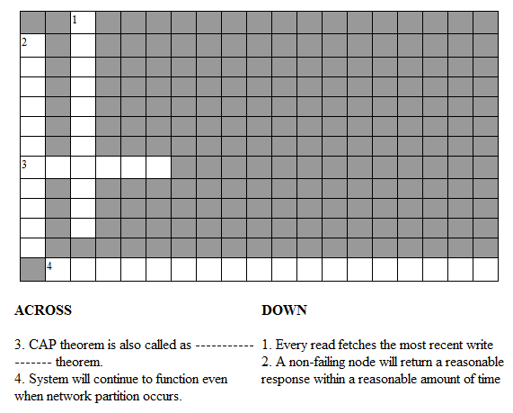
Crossword Puzzle on CAP theorem

Slide 20
Answer Me
What are the key questions to be answered by all organizations stepping into analytics?
What is predictive and prescriptive analytics?

Slide 21
Summary please…
Ask a few participants of the learning program to summarize the lecture.

Slide 22
References …

Slide 23
Further Readings
http://en.wikipedia.org/wiki/Data_science
http://simplystatistics.org/2013/12/12/the-key-word-in-data-science-is-not-data-it-is-science/
http://www.oralytics.com/2012/06/data-science-is-multidisciplinary.html

Slide 24
Thank you

